Slide 1
Classrooms, Kitchens & Farms:
The Narrative Nature of PCK
8th WiPSCSE conference
Aarhus 11th November 2013
Sally Fincher

Slide 2
Classrooms, Kitchens & Farms:
The Narrative Nature of Pedagogical Content Knowledge
8th WiPSCSE conference
Aarhus 11th November 2013
Sally Fincher

Slide 3
Kitchens, Classrooms and Farms?
I’ve chosen to anchor my talk around these three domains as I think the share structural similarities and comparison may afford us new ways of looking on teaching practices.

Slide 4
Characteristics of teacher knowledge
“People think of good and bad teachers as engaged in the same activity, as if education was a substance, and that bad teachers supply a little of the substance, and good teachers supply a lot.”
  Keith Johnstone

Slide 5
Characteristics of teacher knowledge
Teacher’s knowledge is contingent and situated. It relates to this subject, this classroom, these students.
It is embodied. It belongs to individuals, and is constituted from their experiences, beliefs, skills and knowledge.
It is often also tacit. “That’s the way we do things here” or “I do it like that because that’s what works”.

Slide 6
Situated possibilities
Tsui (following Benner) talks of practice as occurring in a space of situated possibilities
“… Being situated means that one is neither totally determined or constrained nor radically free in how one acts. Rather one has situated possibilities, certain ways of seeing and responding that present themselves to the individual in certain situations, and certain ways of seeing and responding that are not available to that individual”

Slide 7
Situated knowledge in other domains: kitchens
I think cooking – and kitchens – have structural similarities to teaching and learning.
Cooking, too, is inevitably situated. It takes place in this kitchen, with these tools, and I am preparing a meal for these eaters.
I have only my own knowledge and skills to draw on “in the moment” and have to deal with emergencies and spills as they happen.
It, too, is a space of situated possibility.

Slide 8
Cooking competence
Use of utensils and appliances
Multitasking
Monitoring and adaptation
Planning
Reproduction of recipes
Cognitive skill
Nutritional knowledge
Comber et al 2013

Slide 9
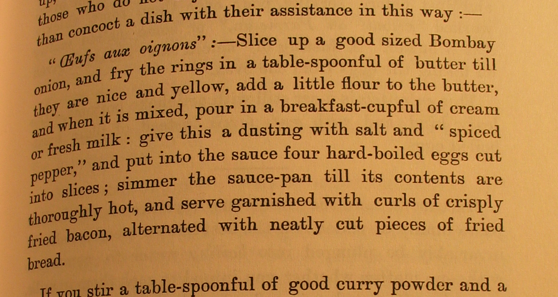
Col. Kenny-Herbert (“Wyvern”) (1878)
A straight
chronological narrative.
Do this first, then do this.
Which means if you follow it chronologically (i.e. you don’t read right through to the end before you begin) you may be nastily surprised

Slide 10
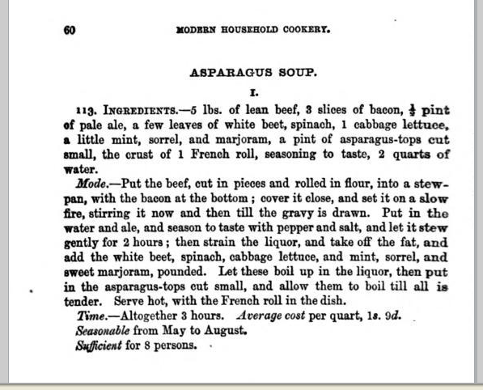
Isabella Beeton (1863)
Separates ingredients from method
Adds some context

Slide 11
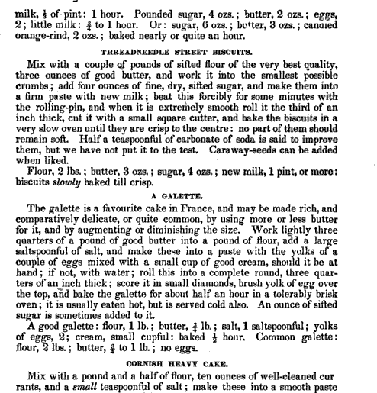
Eliza Acton (1845)
Narrative recipe
then summary
In effect, addressing the needs of novices & experts in one representational form

Slide 12
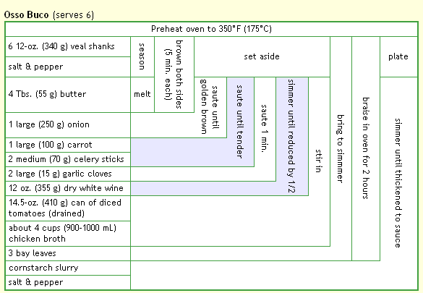
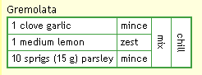
Uncommon form (i)
Don’t forget
the garnish
Diagrammatic form presents ingredients on y axis, time on x axis, “action” on the intersection. Good for overview, but practically unusable (in practice).

Slide 13
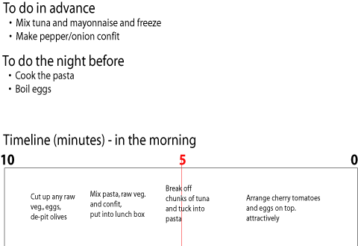
Uncommon form (ii)
Tells you what to have in the store cupboard (joubisai)
Tells you what to have cooked and ready
Counts you down to “zero” – into the bag and out of the door
With a helpful “halfway” point

Slide 14
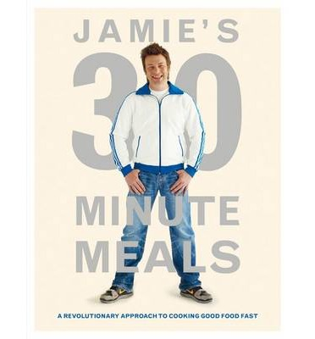
Uncommon form (iii)

Slide 15
Jamie says
“The most revolutionary thing about the meals in this book is not that they can be cooked quickly (they can) and it’s not that they use loads of clever shortcuts and tricks (they do) its that I’ve written them in a completely new way”
“I’m going to walk you through every step needed to create a whole meal, so in 30 minutes you will be putting beautiful main dishes, exciting sides and salads, lovely drinks and puddings, on the table at the same time – all from one recipe!”

Slide 16
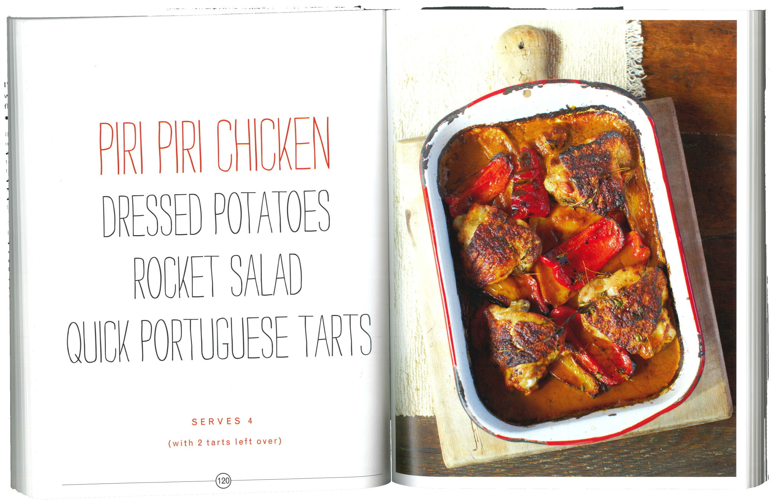

Slide 17
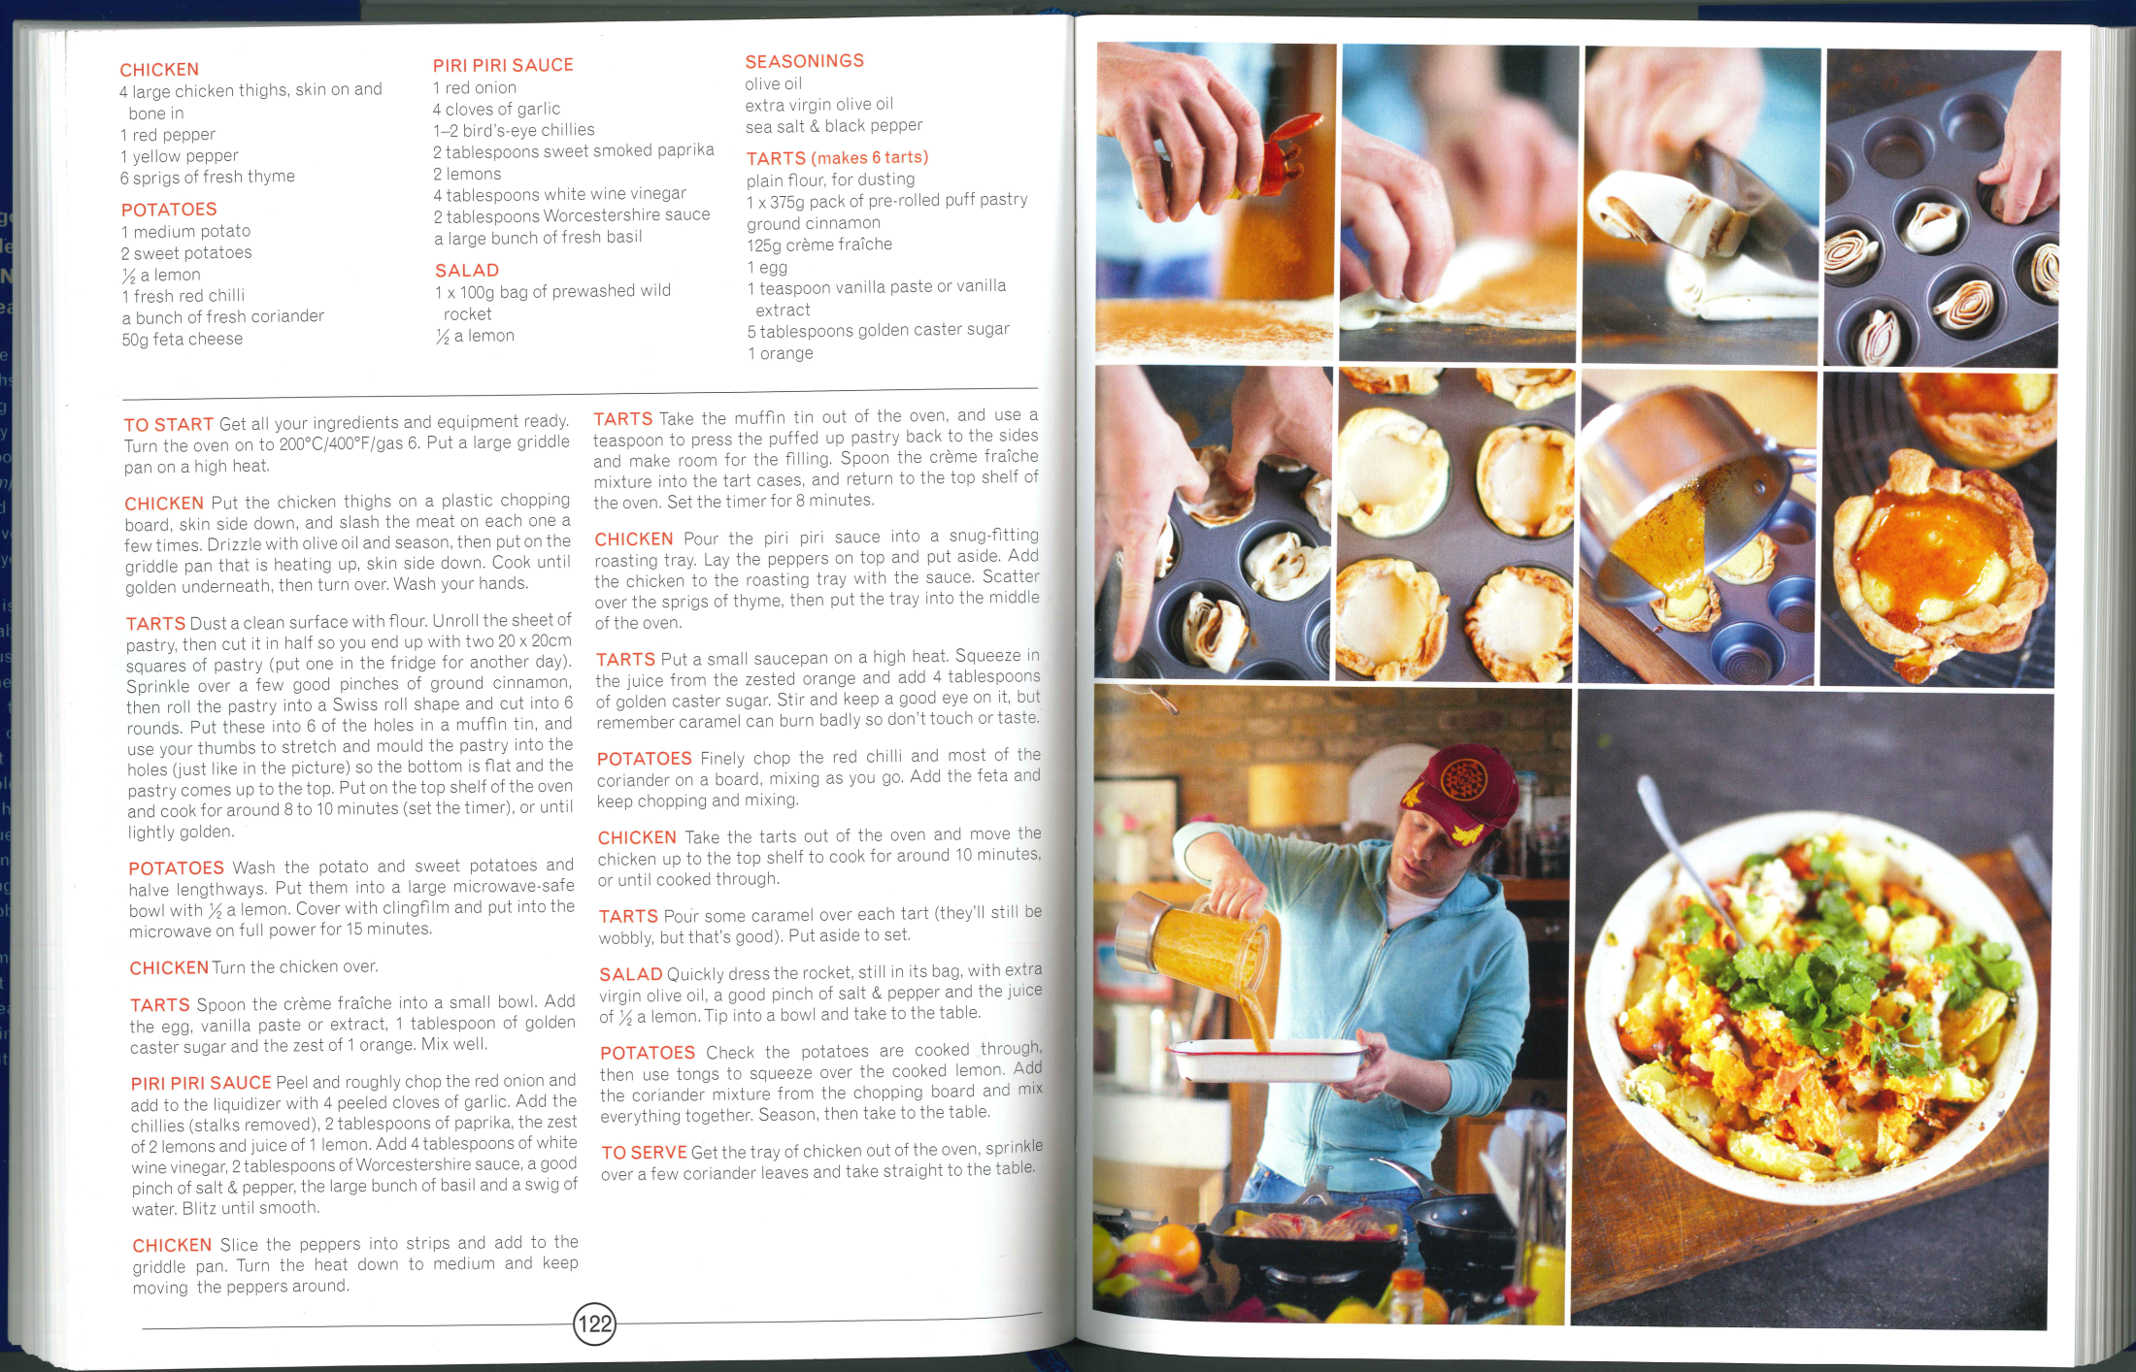

Slide 18
Cooks say
“… unlike other books where it will explain all the steps for the starter then the main for example this book jumps between them all so will tell you to fry the chicken then it will jump to preparing the sides and then to the dessert then back to the chicken.”
9 Dec 2010 Stuart Duncan

Slide 19
Cooks say
“I had such high hopes for this book with it breaking records on sales and '30mins' just sounded fabulous. What Mr Oliver failed to stipulate is that in order to pull it all off within that timescale you need to be Jamie Oliver”
“gemmaloub” 22 Jan 2011

Slide 20
Cooking competence
Use of utensils and appliances
Multitasking
Monitoring and adaptation
Planning
Reproduction of recipes
Cognitive skill
Nutritional knowledge
Comber et al 2013

Slide 21
The problem with recipes
The problem with recipes is that we have to interpret and instantiate them: we have to make them work.
You can have the best recipe for apple pie in the world, but that gives no guarantees of what will come out of your oven.
Cooking is a situated act.

Slide 22
20 Aug 2012 Kath
The only thing this book lacks is stating specific timings. For example it will say things like:
“Put the chicken in the pan.”
“Chop the vegetables.”
“Mix the pudding together.”
“Now take the chicken out.”

Slide 23
20 Aug 2012 Kath
In reality this goes:
“Put the chicken in the pan.”
“Chop the vegetables.”
“Mix the pudding together.”
“Now take the chicken out.”

Slide 24
20 Aug 2012 Kath
In reality this goes:
“Put the chicken in the pan.”
Get colouring pencils for child
“Chop the vegetables.”
“Mix the pudding together.”
“Now take the chicken out.”

Slide 25
20 Aug 2012 Kath
In reality this goes:
“Put the chicken in the pan.”
Get colouring pencils for child
“Chop the vegetables.”
Answer phone to cold caller
“Mix the pudding together.”
“Now take the chicken out.”

Slide 26
20 Aug 2012 Kath
So I have to guess at what point the chicken needs to actually come out of the pan. It would be really useful if each time something has to go in for a specific time this is written down as a NUMBER, not as a ‘time to do the veg’ or some such.

Slide 27
V. I. Litvine, 17 Oct 2010
With this cookbook, I find it difficult to chop-and-change when the recipe I am keen on is intertwined in a maze of instructions for the whole meal. No explicit cooking times are given. Some components of meals are not really recipes on their own (I do not need a cookbook to tell me to sprinkle a flatbread with oregano and warm it in the oven).

Slide 28
V. I. Litvine, 17 Oct 2010
With this cookbook, I find it difficult to chop-and-change when the recipe I am keen on is intertwined in a maze of instructions for the whole meal. No explicit cooking times are given. Some components of meals are not really recipes on their own (I do not need a cookbook to tell me to sprinkle a flatbread with oregano and warm it in the oven).

Slide 29
Relevance structure
Bowden and Marton talk (of teaching) emerging out of “relevance structures”
“The way in which a particular experience relates to the personal context and the way in which the personal context is making certain aspects of the particular situation appear more important than others, making them come to the fore, while others remain in the background, defines the relevance structure of the situation.”

Slide 30
Situated knowledge in other domains: farms
Farming also is inevitably situated.
I’m growing things on this soil, in this climate, in this season.

Slide 31
Situated knowledge in other domains: farms
Farming also is inevitably situated.
I’m growing things on this soil, in this climate, in this season.
“... to be successful [farming] requires an enormous amount of tacit knowledge, and understanding about how to make things work in a co-ordinated way, and success has a long time frame.”
Seb Schmoller, CAMEL project

Slide 32
Uruguayan farmers
Farmers from 8 small farms used to meet monthly, taking turns to visit one another’s establishments.
Participants were provided with prior information including plans and stock lists.
Seb Schmoller’s story

Slide 33
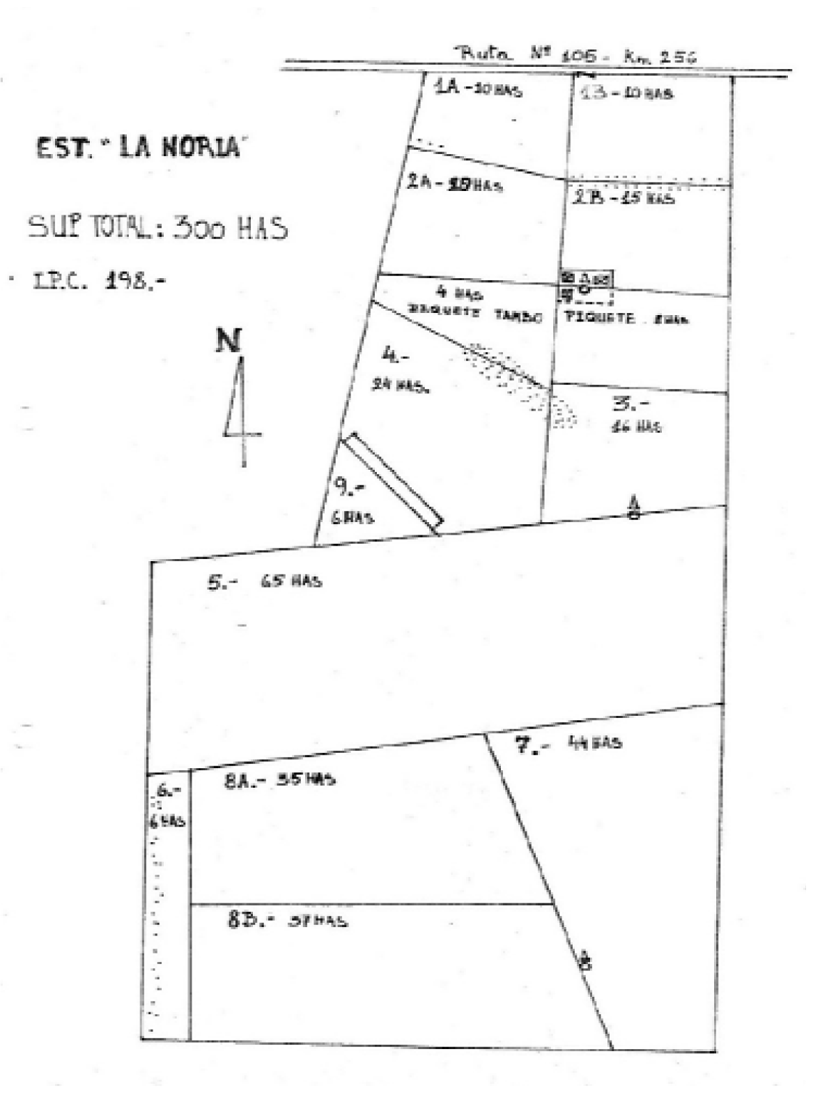
Seb Schmoller’s story

Slide 34
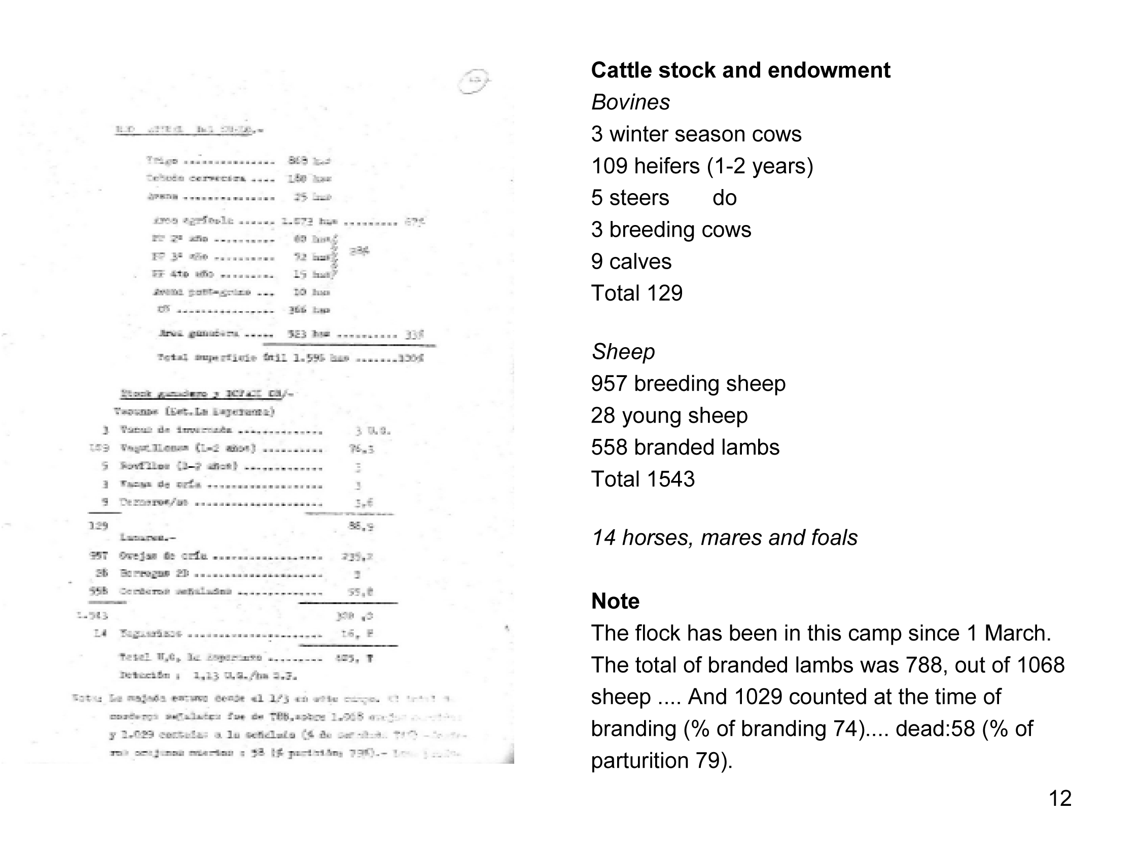
Seb Schmoller’s story

Slide 35
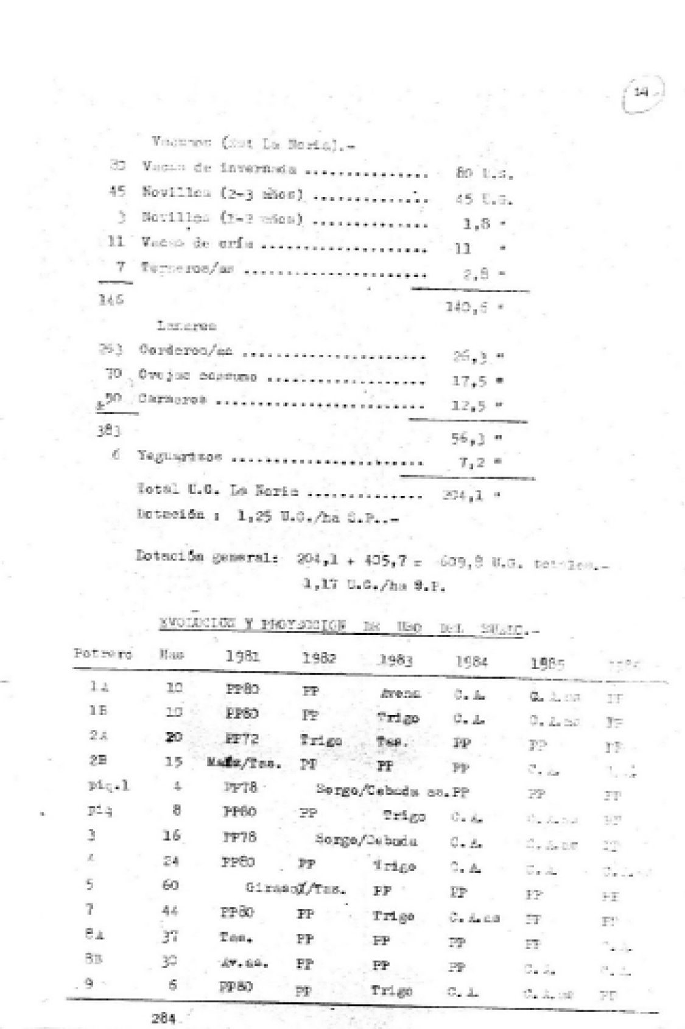
Rubric for the table
Evolution and projection of the use of the land giving size of fields and crops grown from 1981 to 1985 in rotation: wheat, sunflower, sorghum, oats, barley, maize.
Seb Schmoller’s story

Slide 36
Uruguayan farmers
Farmers from 8 small farms used to meet monthly, taking turns to visit one another’s establishments.
Participants were provided with prior information including plans and stock lists.
On the day of the visit they toured the farm then had a discussion (led by an expert facilitator) about key issues arising and gave views on topics on which the host sought the group’s advice.
There was an evaluation session at the end of the day and the outcomes were documented.
Seb Schmoller’s story

Slide 37
Nicholas Kent (Seb Schmoller’s Great Uncle)
6 June 2006
Another point was the insistence that the meeting should be “with underpants removed” which means that you have to put all your cards on the table and hide nothing, and often we required the presence of the wife to sound out her views.
At the end of the meeting the leaders of the group reported on all their group recommendations and sometimes there emerged some truths or criticisms which were very painful, and this is what I think helped many to come to terms with reality.
Seb Schmoller’s story

Slide 38

Situated knowledge in teaching
http://www.sharingpractice.ac.uk

Slide 39
Sharing Practice project
Sharing Practice:
How do educators discover “what works”?
Representing Practice:
What is an appropriate representation of teaching practice?
Adopting Practice:
How does educators’ practice change over time?

Slide 40
Teaching competence: Lee Shulman
content knowledge.
general pedagogical knowledge, with special reference to those broad principles and strategies of classroom management and organisation that appear to transcend subject matter.
curriculum knowledge, with particular grasp of the materials and programmes that serve as ‘tools of the trade’ for teachers.
pedagogical content knowledge, that special amalgam of content and pedagogy that is uniquely the province of teachers, their own special form of professional understanding.
knowledge of learners and their characteristics.
knowledge of educational contexts, ranging from the workings of the group or classroom, the governance and financing of school districts, to the character of communities and cultures.
knowledge of educational ends, purposes and values, and their philosophical and historical grounds.

Slide 41
Situated knowledge in teaching
“Actually, I don’t know how others teach sorting, you, or my colleagues. That is a bit shocking. I don’t know how other people teach something as fundamental as sorting. I know what the algorithm is. And the textbooks. But how do others get students through that?” (SP9)

Slide 42
So what can we do?
What would it mean for us to have a forum – a community – that allowed us to purposefully reflect on teaching as itself?
That did not try to make teaching into something else, and did not document it in a decontextualised, abstract way (writing a paper is a terrible way to represent teaching).
What would that look like?

Slide 43

http://www.disciplinarycommons.org

Slide 44
Disciplinary Commons: Aims
To document and share knowledge about teaching and student learning.
To establish practices for the scholarship of teaching by making it public, peer-reviewed, and amenable for future use and development by other educators: creating a teaching-appropriate document of practice equivalent to the research-appropriate journal paper.

Slide 45
Disciplinary Commons: Structure
A Commons is constituted from 10-20 educators sharing the same disciplinary background, teaching the same subject – sometimes the same module – in different institutions.
Meet monthly throughout an academic year.

Slide 46
Disciplinary Commons
A Disciplinary Commons affords two benefits

Slide 47
Disciplinary Commons
A Disciplinary Commons affords two benefits, participation and reification

Slide 48
Disciplinary Commons: Participation
In meetings we reflect, we share. We observe, we review.
We have the deep and meaty discussions about the minutae of our practice.
And – although with our underpants on – these discussions are often of a particular kind.
For, like farming, to be successful, teaching also
“ ... requires an enormous amount of tacit knowledge, and understanding about how to make things work in a co-ordinated way, and success has a long time frame.”

Slide 49
Let me tell you about Bob and Alice
(not their real names)
An early activity in Alice’s intro course is to have students use pseudocode and flowcharts to describe how to select the second largest element of a list.
Alice: “This section seems really really hard for students”
Bob: I mentioned that I thought the logic was quite challenging for students as a first time exposure to selection. I asked her why such nested logic (2 levels for "largest", 3 levels of "2nd largest"), when she teaches selection several weeks later. I asked "what is the point".

Slide 50
Using “the tools” – pseudocode & flowcharts
I suggested that she might want to have students use manipulatives, say, cards with numbers on them. I said, here is how to use them the wrong way.
9
11
4

Slide 51
Using “the tools” – pseudocode & flowcharts
Ask students to pick the largest of 3 numbered cards, writing down how they did it.
Students will just say "I took the largest".
9
11
4

Slide 52

Using “the tools” – pseudocode & flowcharts
I said that you have to constrain the task: place the 3 cards face down, and choose the largest of the three when you can have at most 2 up at a time.
9
11
4

Slide 53
Using “the tools” – pseudocode & flowcharts
Or get them to choose the largest when you only hand them out one at a time.
11
9
4

Slide 54
Using “the tools” – pseudocode & flowcharts
... You could do this in groups: one person doing it and the other person observing and recording process. Then they can discuss the algorithm, try it on other values to see if it generalizes. Then they can do it as a whole class, and you can critique. With this method that they might be able to even do the "2nd largest" -- but you’ll have to settle for very rough pseudocode, and certainly not flowcharts.

Slide 55
Teaching competence: Lee Shulman
content knowledge.
general pedagogical knowledge, with special reference to those broad principles and strategies of classroom management and organisation that appear to transcend subject matter.
curriculum knowledge, with particular grasp of the materials and programmes that serve as ‘tools of the trade’ for teachers.
pedagogical content knowledge, that special amalgam of content and pedagogy that is uniquely the province of teachers, their own special form of professional understanding.
knowledge of learners and their characteristics.
knowledge of educational contexts, ranging from the workings of the group or classroom, the governance and financing of school districts, to the character of communities and cultures.
knowledge of educational ends, purposes and values, and their philosophical and historical grounds.
pedagogical content knowledge, that special amalgam of content and pedagogy that is uniquely the province of teachers, their own special form of professional understanding.

Slide 56
Pedagogical Content Knowledge
This conversation emerged from Bob having done this sort of thing, from knowing what students will do and say about learning a particular topic.
And of course, Alice could understand the response, because she had similarly deep disciplinary experience to draw on as well.
This conversation was all about the specifics. In a cross-disciplinary group, you would NEVER have that kind of conversation. You might have other very good and important things to say to one another, but you wouldn't have that conversation, never.

Slide 57
Teaching competence: Sigrun Gudmundsdóttir
PCK is not just “increased repertoire” (experienced but not expert).
Expression of PCK in practice.
Part of the development of PCK is teachers’ construction of “curriculum stories”, their ways of conveying linkage and meaning to students.

Slide 58
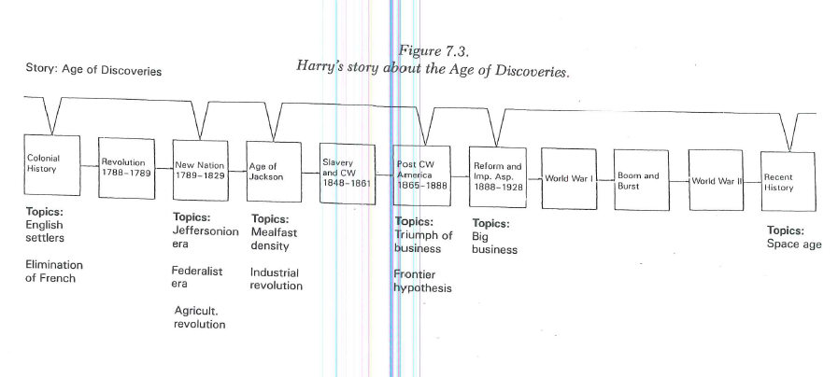

Slide 59
Narrative as carrier of expertise
Curriculum stories make material meaningful for students. They point up what is salient, what needs to be paid attention to, what links with what.
Curriculum stories can also be shared with other teachers, to articulate content and “take”.

Slide 60
A special form of professional understanding
It may be – and I suggest it’s likely, I’m beginning to believe it’s true – that pedagogical content knowledge is only transmitted by narrative.
By disciplinary practitioners talking together.
Certainly, the disciplinary narrative here bridges the gap between abstract “textbook” recipes to concrete classroom practice.
And, narrative – not a textbook, not a “best practice”, not a codified and context-free representation – has allowed Bob and Alice to usefully share knowledge between institutions.

Slide 61
Commons participation elicits narrative
Because while it’s trivial to recognise a story, it is hard to compel their emergence. They naturally arise in response to a situation, either our own or someone else’s.
  War stories are about problems, issues, difficulties and triumphs. They have a need to be told: “Let me tell you what happened to me today …” and they solicit sympathy and advice: interpretations, counter-narratives, “amen” encouragement. (J. J. White, 1991, p. 251)
It is difficult (if not impossible) to recreate the need to tell a story. Unless it is “present” somehow for the teller, then the response will be awkward and contrived.

Slide 62
Disciplinary Commons: Reification
Documentation of teaching practice is:
  Rare
  In non-standard (& therefore non-comparable) forms
Commons portfolios have:
  Common form
  Persistent, peer-reviewed deliverable
Power of portfolios is multiplied when there are several examples available for a disciplinary area
Commons archives provide a rich set of contextualised data

Slide 63
Disciplinary Commons: Portfolio form
Have six sections:
  Context
  Content
  Instructional Design
  Delivery
  Assessment
  Evaluation

Slide 64
Not the only form – not the only recipe
Bundles
CoRe

Slide 65
Springer
2001
267 pages
46 bundles
Fincher, Petre, Clark, Utting, Boyle, Mander

Slide 66
EPCoS Bundle Form
Problem Statement | Each bundle starts with a formulation of a general problem to which the body of the bundle is a specific solution.
Body | The Body of each bundle is presented in a format that shares certain formulaic phrases. These are:
 | This Bundle ... A phrase which captures the essence of the practice
 | The way it works is ... A description of what is involved (this may be quite short, or many paragraphs long. Occasionally it will be many pages, sometimes including detailed documentation.)
 | It works better if ... Key criteria for success
 | It doesn’t work if ... Watchpoints for unsuitable (or undesirable) situations
Solution Statement | Following the body of the bundle is a general solution which refers back to the initial problem statement. (The solution statement, of course, captures the aim of the body too, because a bundle is itself a specific instance of the general solution).

Slide 67
Bridging the gap
Bundle form and the formulaic phrases help structure the singular experience to facilitate sharing
Narrative “body” helps to connect teller and listener.
I know that this practice is real—it’s close to the work—it has been developed and deployed “in anger”

Slide 68
Sharing Practice Project
The form didn’t work for everyone.
Re-purposed for a different group, to reflect their language and needs.

Slide 69
Jack Loughran’s CoRe
An explicit attempt to uncover and represent PCK

Slide 70
Content Representation (CoRe)
What you intend the students to learn about this idea?
Why is it important for students to know this?
What else do you know about this idea (that you do not intend students to know yet)?
Difficulties, or limitations, connected with teaching this idea.
Knowledge about the students’ thinking which influences your teaching of this idea.
Other factors that influence your teaching of this idea.
Teaching procedures (and particular reasons for using these to engage with this idea).
Specific ways of ascertaining students’ understanding or confusion around this idea (include likely range of responses).

Slide 71
ACM Exemplar template (extract)
Where does the course fit in your curriculum?
What is covered in the course?
What is the format of the course?
How are students assessed?
Course textbooks and materials
Why do you teach the course this way?

Slide 72
Disciplinary Commons: Portfolio form
Have six sections:
  Context
  Content
  Instructional Design
  Delivery
  Assessment
  Evaluation
Each section consists of an artefact and a commentary.
Detail and discussion.
Evidence and narrative.
What and why.
Personal, but not idiosyncratic

Slide 73
Benefits of the Commons
All Commoners are expert
Commoners work together to discover, interpret and re-interpret new material
Part of the sharing is cross-institutional peer observation of teaching.
We gain an unusual depth of knowledge about practice in other institutions. Knowledge normally only otherwise acquired through a process of “charismatic embedding”
Resultant public documentation is contextual, comparative and collegial – and inevitably one step (or 10, or 17 steps) from singular tacit, embodied experience

Slide 74
Recommendation domain
Byerlee, Harrington, & Winkelmann, 1982 say:
“… we have proposed the concept of a recommendation domain (RD) as a group of farmers with roughly similar practices and circumstances for whom a given recommendation will be broadly appropriate. It is a stratification of farmers, not area; farmers, not fields, make decisions … resulting domains are often not amenable to geographical mapping because farmers of different domains may be interspersed in a given area.”

Slide 75
Bridging the gap
This narrative knowledge is not a “recipe” – I read a portfolio to find out how someone else taught the course, not to be instructed how I should do it.
Reading their story allows their experiences to become my own, allows me to gauge what will work for me.
It supports and builds my own expertise, my own PCK.

Slide 76
Narrative nature of PCK: three facets
Narrative in elicitation
  response to situation/story (Bob and Alice)
Narrative in expression
  Narrative as the carrier of practical experience and foundation for development of expertise (Gudmundsdottir and Benner)
Narrative in representation
  Portfolios (amongst others – see also Bundles, CoRe, ACM exemplar template)

Slide 77
References
Uruguayan farmers’ groups are described by Seb Schmoller in: The CAMEL Project: Collaborative Approaches to the Management of E-Learning, JISC 2006. Available from: http://www.jiscinfonet.ac.uk/camel
Nicholas Kent (who provided the documents and notes) is Seb’s Great Uncle
Gumundsdóttir, Sigrun Curriculum Stories: Four Case Studies of Social Studies Teaching in Day, C., Pope, M. L., & Denicolo, P. (1990). Insights into teachers' thinking and practice. London: Falmer.
Benner, P. A., Tanner, C. A., & Chesla, C. A. (1996). Expertise in nursing practice : caring, clinical judgement and ethics. New York: Springer Pub. Co.
Bowden, J. A., & Marton, F. (1998). The university of learning. London: RoutledgeFalmer, 2004.
Rob Comber, Jettie Hoonhout, Aart T. van Halteren, Paula Moynihan, Patrick Olivier, Food Practices as Situated Action: Exploring and Designing for Everyday Food Practices with Households CHI2013
Keith Johnstone, Impro (Performance Books): Improvisation and the Theatre, Methuen Drama, 2007
Tsui, A. B. M. (2010). Cultural Contexts and Situated Possibilities in the Teaching of Second Langage Writing. Journal of Teacher Education, 61(4), 364-375.

Slide 78
Recipe Representation References
Isabella Beeton The Book of Household Management, Jonathan Cape,1863
Eliza Acton Modern Cookery, In All Its Branches: Reduced to a System of Easy Practice, For The use of Private Families, Lea and Blanchard,1845
Col. Arthur Robert Kenney-Herbert (“Wyvern”) Culinary Jottings for Madras, 1885 (facsimile reproduction, Prospect Books, 1994)
Cooking for Engineers, http://www.cookingforengineers.com/recipe/200/Osso-Buco
Just Bento no. 40
http://justbento.com/bento-no-40-pasta-salad-nicoise-with-a-twist
Jamie Oliver Jamie's 30-Minute Meals: A Revolutionary Approach to Cooking Good Food Fast, Michael Joseph, 2010

Slide 79
Teaching Representation References
Bundles
  EPCoS Project, http://www.cs.kent.ac.uk/national/EPCOS/
  Computer Science Project Work: Principles and Pragmatics, Sally Fincher, Marian Petre & Martyn Clark, Springer-Verlag, 2001.
  Sharing Practice Project: http://www.sharingpractice.ac.uk
  Representing Teaching Practice: A Book of Bundles, Janet Finlay, University of Kent Press, 2011
Content Representation (CoRe)
  Loughran, J., Berry, A., & Mulhall, P. (2006). Understanding and Developing Science Teachers' Pedagogical Content Knowledge. Rotterdam: Sense Publishers.
ACM Exemplars
  http://ai.stanford.edu/users/sahami/CS2013/

Slide 80
This work is licensed under a Creative Commons Attribution-NonCommercial-ShareAlike 2.5 License.

